Slide 1
Distributed FS Reliability
Demo 1
Akshay Katira, Sameer Sinha, Shilin Zhou, Srikar Yagavandla, Xinyi Chen

Slide 2
Background

Slide 3
Overview of the Project
Terraform
Ansible
MooseFS
OpenStack MOC VMs

Slide 4
Ansible
Open source IT engine
Automates application deployment
Cloud Provisioning

Slide 5
Terraform
<Content>

Slide 6
MooseFS
<Content>

Slide 7
Our Direction

Slide 8
Primary Goal
Framework for basic failure testing
Openstack VM

Slide 9
Solution Architecture Overview
OpenStack VMs
Management VM
Private Network
Terraform
Creates VMs
Ansible
Configures & Installs MooseFS
Testing framework workflows

Slide 10
Work Done this Sprint

Slide 11
Setting Up Environment
Setting up MOC VMs on OpenStack
Install Ansible on Management VM
Install Terraform on Management VM
Install MooseFS manually on Cluster VMs

Slide 12
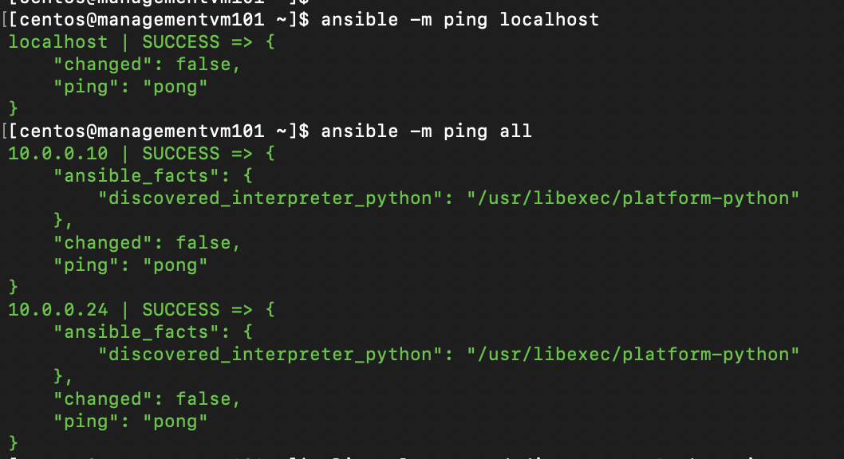
Setting Up Ansible Connection

Slide 13
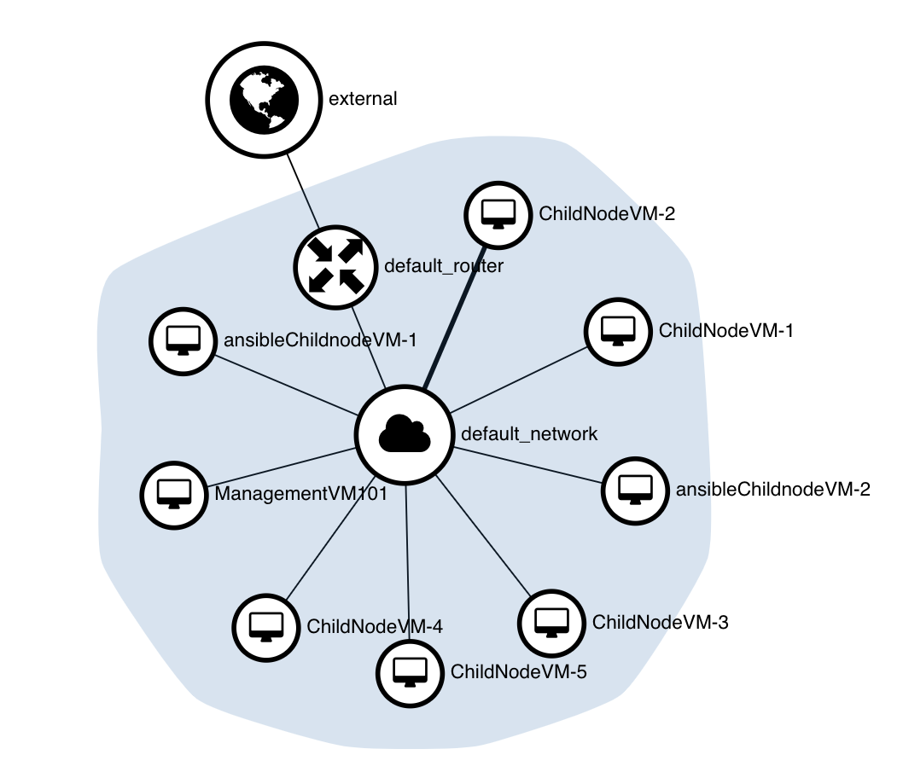
Setting Up Private Network

Slide 14
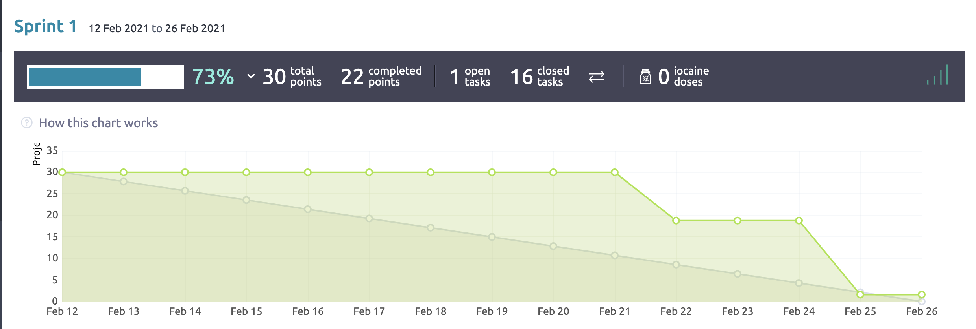
Sprint 1 Burndown Chart

Slide 15
Next Sprint
Propose workflow APIs in JAVA
Automate MooseFS installation using Ansible
Integrate Terraform & Ansible

Slide 16
Future Work
5 different failure scenarios

Slide 17
Our Open Questions
Terraform installation & integration
Workflow APIs

Slide 18
Questions from the Audience

